Slide 1
USACE Savannah District Briefing 29 June 2022
Colonel Joseph R. Geary
District Commander
USACE, Savannah District

Slide 2
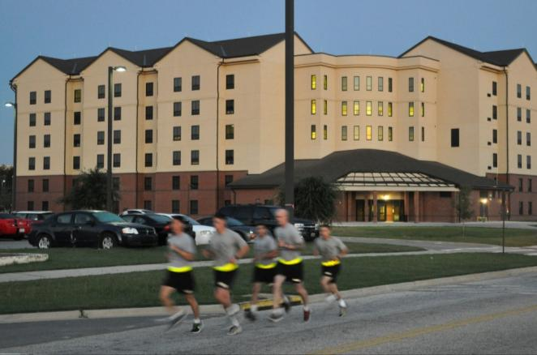
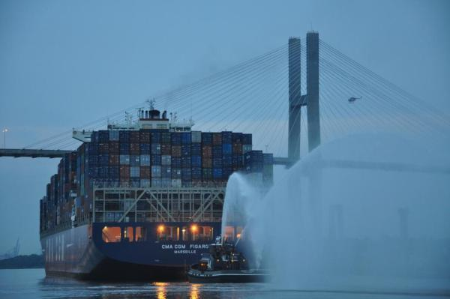
Savannah District Mission
Building Strong for America!
Provides facilities for Soldiers, Airmen and families
Enables free-flow of commerce
Conserves and protects the region’s water and natural resources
Enhances family recreation

Slide 3
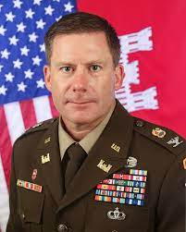
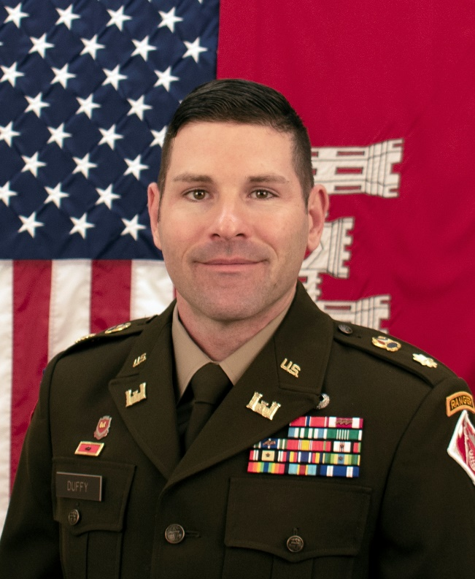
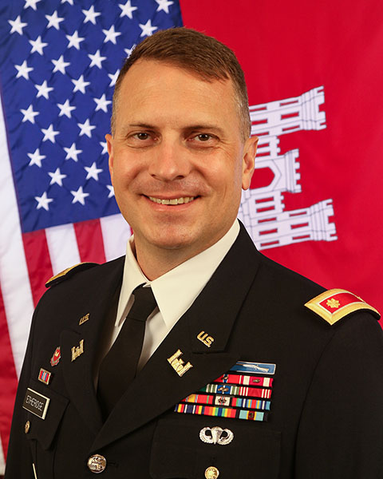
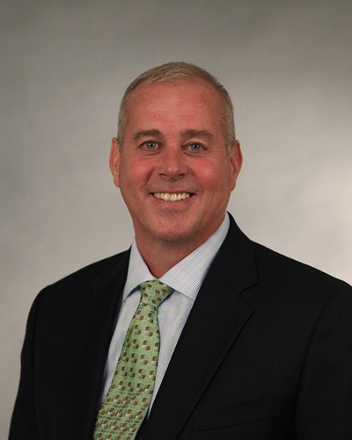
Savannah District Leadership
COL Joseph R. Geary
District Commander
Maj Alex Duffy
District Deputy Commander
MAJ Robert Etheridge
Deputy Commander
for Cyber Transformation
Erik Blechinger
Deputy District Engineer
Programs and Project Management

Slide 4
Savannah District Boundaries
Hartwell
Dam & Lake
NC
Seymour
Johnson AFB
SC
R. B. Russell
Dam & Lake
GA
Environmental
Boundary
NC
Pope AAF
J. Strom Thurmond
Dam & Lake
Ft. Bragg
Fort Jackson
Wilmington District
Dobbins ARB
Shaw AFB
Joint Base Charleston
Gillem Enclave
SC
Formerly Used
Defense Sites
Boundary
GA
Charleston District
Robins AFB
Savannah Harbor
(Savannah District HQ)
Ft. Gordon
Ft. Benning
Civil Works
Boundary
Ft. Stewart/HAAF
Moody AFB
FLETC
NPS Andersonville
Interagency Services and Regulatory
Boundary
Homeowner’s Assistance Program includes entire U.S. and Overseas.
Real Estate Boundary includes Army Central Command AOR
Notes:
12 Major Military Installations (5 Air Force, 7 Army)
Manage one of Corps’ largest military design and construction program in terms of dollars and projects.
Civil Works responsibilities encompass two-thirds of eastern Georgia.
Military design and construction boundaries cover the states of GA, NC and SC - 7 Army and 6 Air Force installations, and 1 Navy installation.
Perform new work and maintenance dredging in two primary deep water ports on East Coast, Savannah and Brunswick Harbors; maintain significant portion of the Atlantic Intracoastal Waterway.
Operate 3 multipurpose dam and lake projects on upper Savannah River - Hartwell, Richard B. Russell and J. Strom Thurmond.
Regulatory boundaries cover the entire state of Georgia.
Real Estate division handles property acquisition, disposal, leasing and forest management for Savannah, Charleston and Wilmington Districts. HAP – Eastern half of US. Program spans 10 time zones.

Slide 5
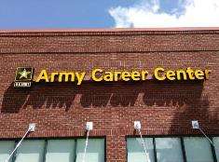
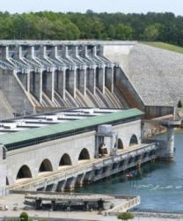
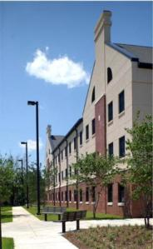
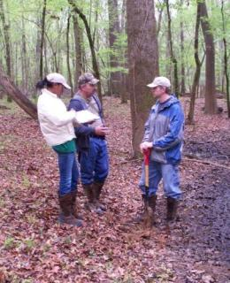
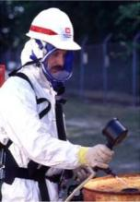
SAVANNAH DISTRICT’S WORKLOAD
Fiscal Year 2022
Real Estate $39M
Civil Works $184M
Military $520M
Total: $817 million
Regulatory $4.9M
Environmental $69M

Slide 6
SAS Workload Trends
Dollars in 000

Slide 7
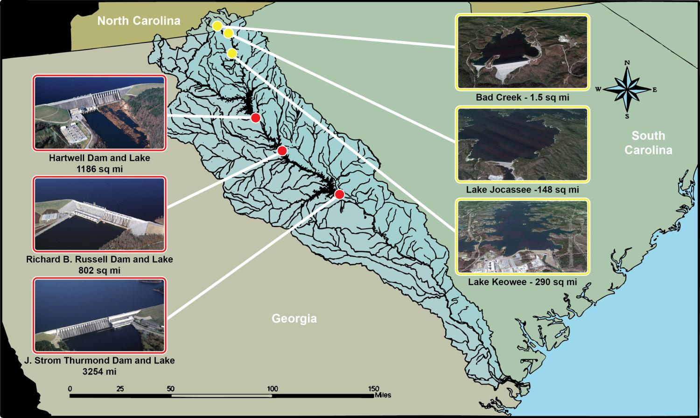
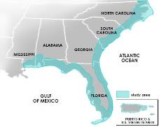
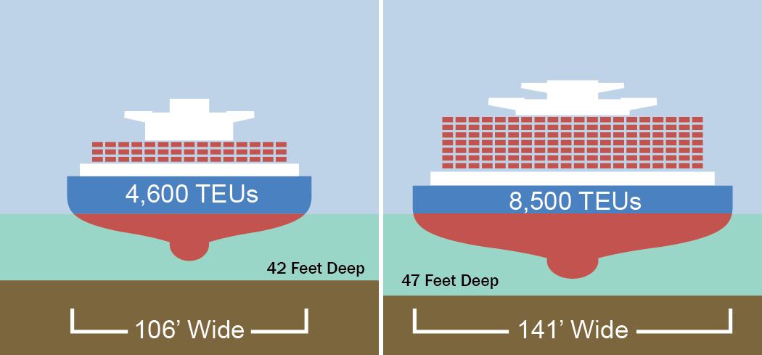
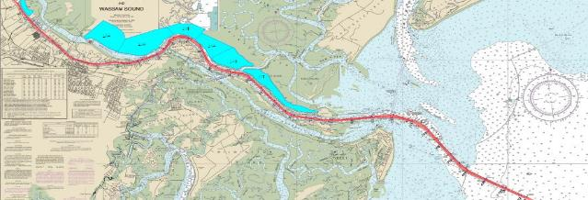
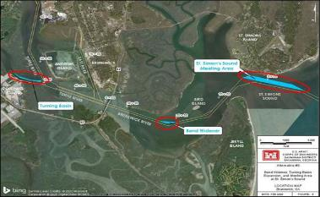
Civil works: FY22 Program $96M
Savannah Harbor Expansion Project
South Atlantic Coast Study
Savannah River Basin
Water Management
Deepen 5 feet
Lengthen channel 7 miles
$282M annual net benefits
Cost $1.019B
BCR: 7.3 to 1
2,500 miles of coastline
Habitat for 217 listed species
$572B in property value
2.5M Flood Insurance Policies
3 Hydroelectric dams
10,580 Sq miles drainage basin
$370M flood damage prevention
Avg. $87M to Treasury each year
1.21 GWH clean energy
Brunswick Harbor
Modification Study
Savannah and Brunswick Harbor
Operations and Maintenance
Cost: $20+ million
551k CY
BCR: 2.4 to 1

Slide 8
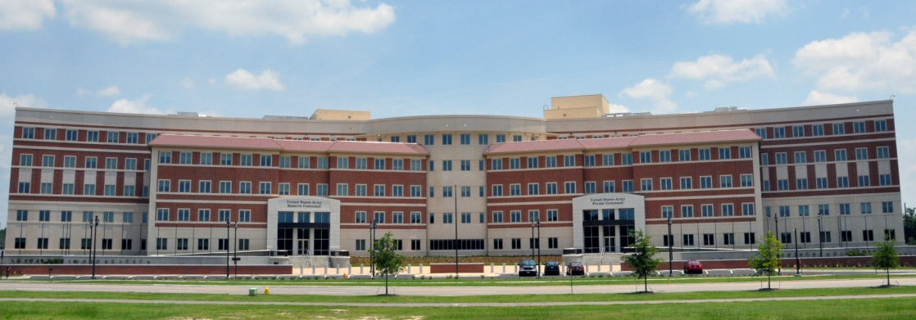
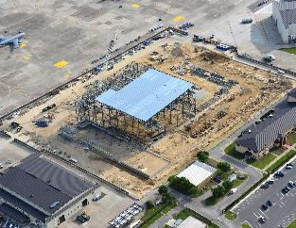
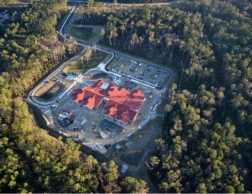
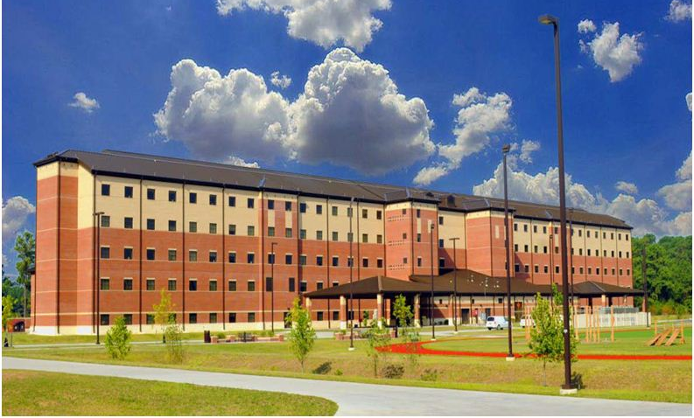
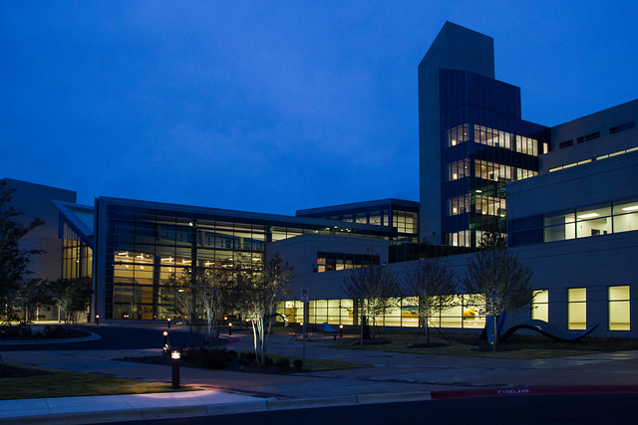
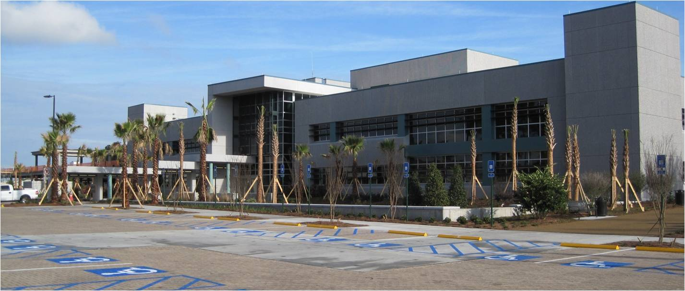
MILITARY CONSTRUCTION
Marshall Hall at Fort Bragg
KC-46A Hangar at Seymour-Johnson AFB
Elementary School at Fort Stewart
AIT Barracks at Fort Benning
New Hospital Complex at Fort Benning
Community Hospital at Fort Stewart

Slide 9
GATEWAY TO SUCCESS
Do your homework & understand our mission
Schedule a meeting with the Small Business Office
Jennifer Cavanagh, Jennifer.S.Cavanagh@usace.army.mil (912) 652-5539
https://www.sas.usace.army.mil/Business-With-Us/Small-Business/
Register in the “System for Award Management” (SAM) www.sam.gov
Be AWARE of announcements – business opportunity notifications, industry days, and federally attended meetings in the area
SUCCESS

Slide 10
Contact Information
Jennifer Cavanagh, Chief, Small Business Office
Jennifer.S.Cavanagh@usace.army.mil (912) 652-5539
Paige Blechinger, Chief, Contracting Division
Paige.H.Blechinger@usace.army.mil (912) 652-6177
Glenn Marks, Chief, Reimbursable Programs & Project Management
Andrew.G.Marks@usace.army.mil (912) 652-5597
Michael Chirpich, Chief, Civil Works Programs & Project Management
Michael.C.Chirpich@usace.army.mil (912) 652-6162
Kim Garvey, Chief, Planning Branch
Kimberly.L.Garvey@usace.army.mil (912) 652-5968
Anthony Cady, Chief, Military Programs & Project Management
Anthony.E.Cady@usace.army.mil (912) 652-5642
Thomas E. Woodie, Assistant Chief, Planning, Programs and Project Mgmt
Thomas.e.Woodie@usace.army.mil (912) 652-5792

